Slide 1
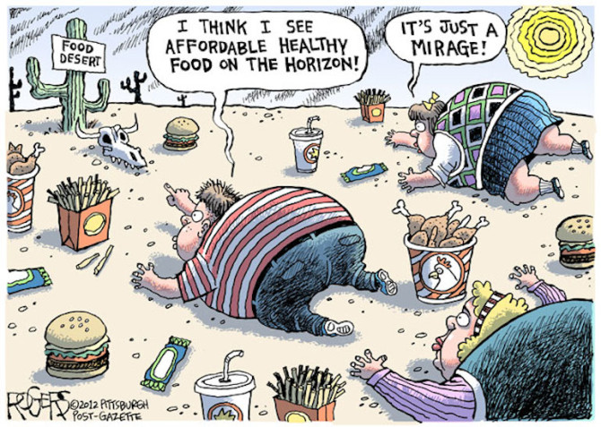
Food DESERT and Health
Introduction to Programming for Public Policy: Final Project 12/4/2017
Adriana Artola and Shinya Takatani

Slide 2
Question
Does the access to healthy food in supermarkets improve health outcomes?
Otherwise, do food deserts cause increased lifestyle diseases such as diabetes, obesity or hypertension?

Slide 3
datasets
Access to Food
Grocery location and size
Fast food restaurants location
Healthcare Outcome
Diabetes hospitalization
Geometry
Zip codes boundaries
Other Explanation Variables
Black/Hispanic rate
Income
Education attainment
Poverty rate

Slide 4
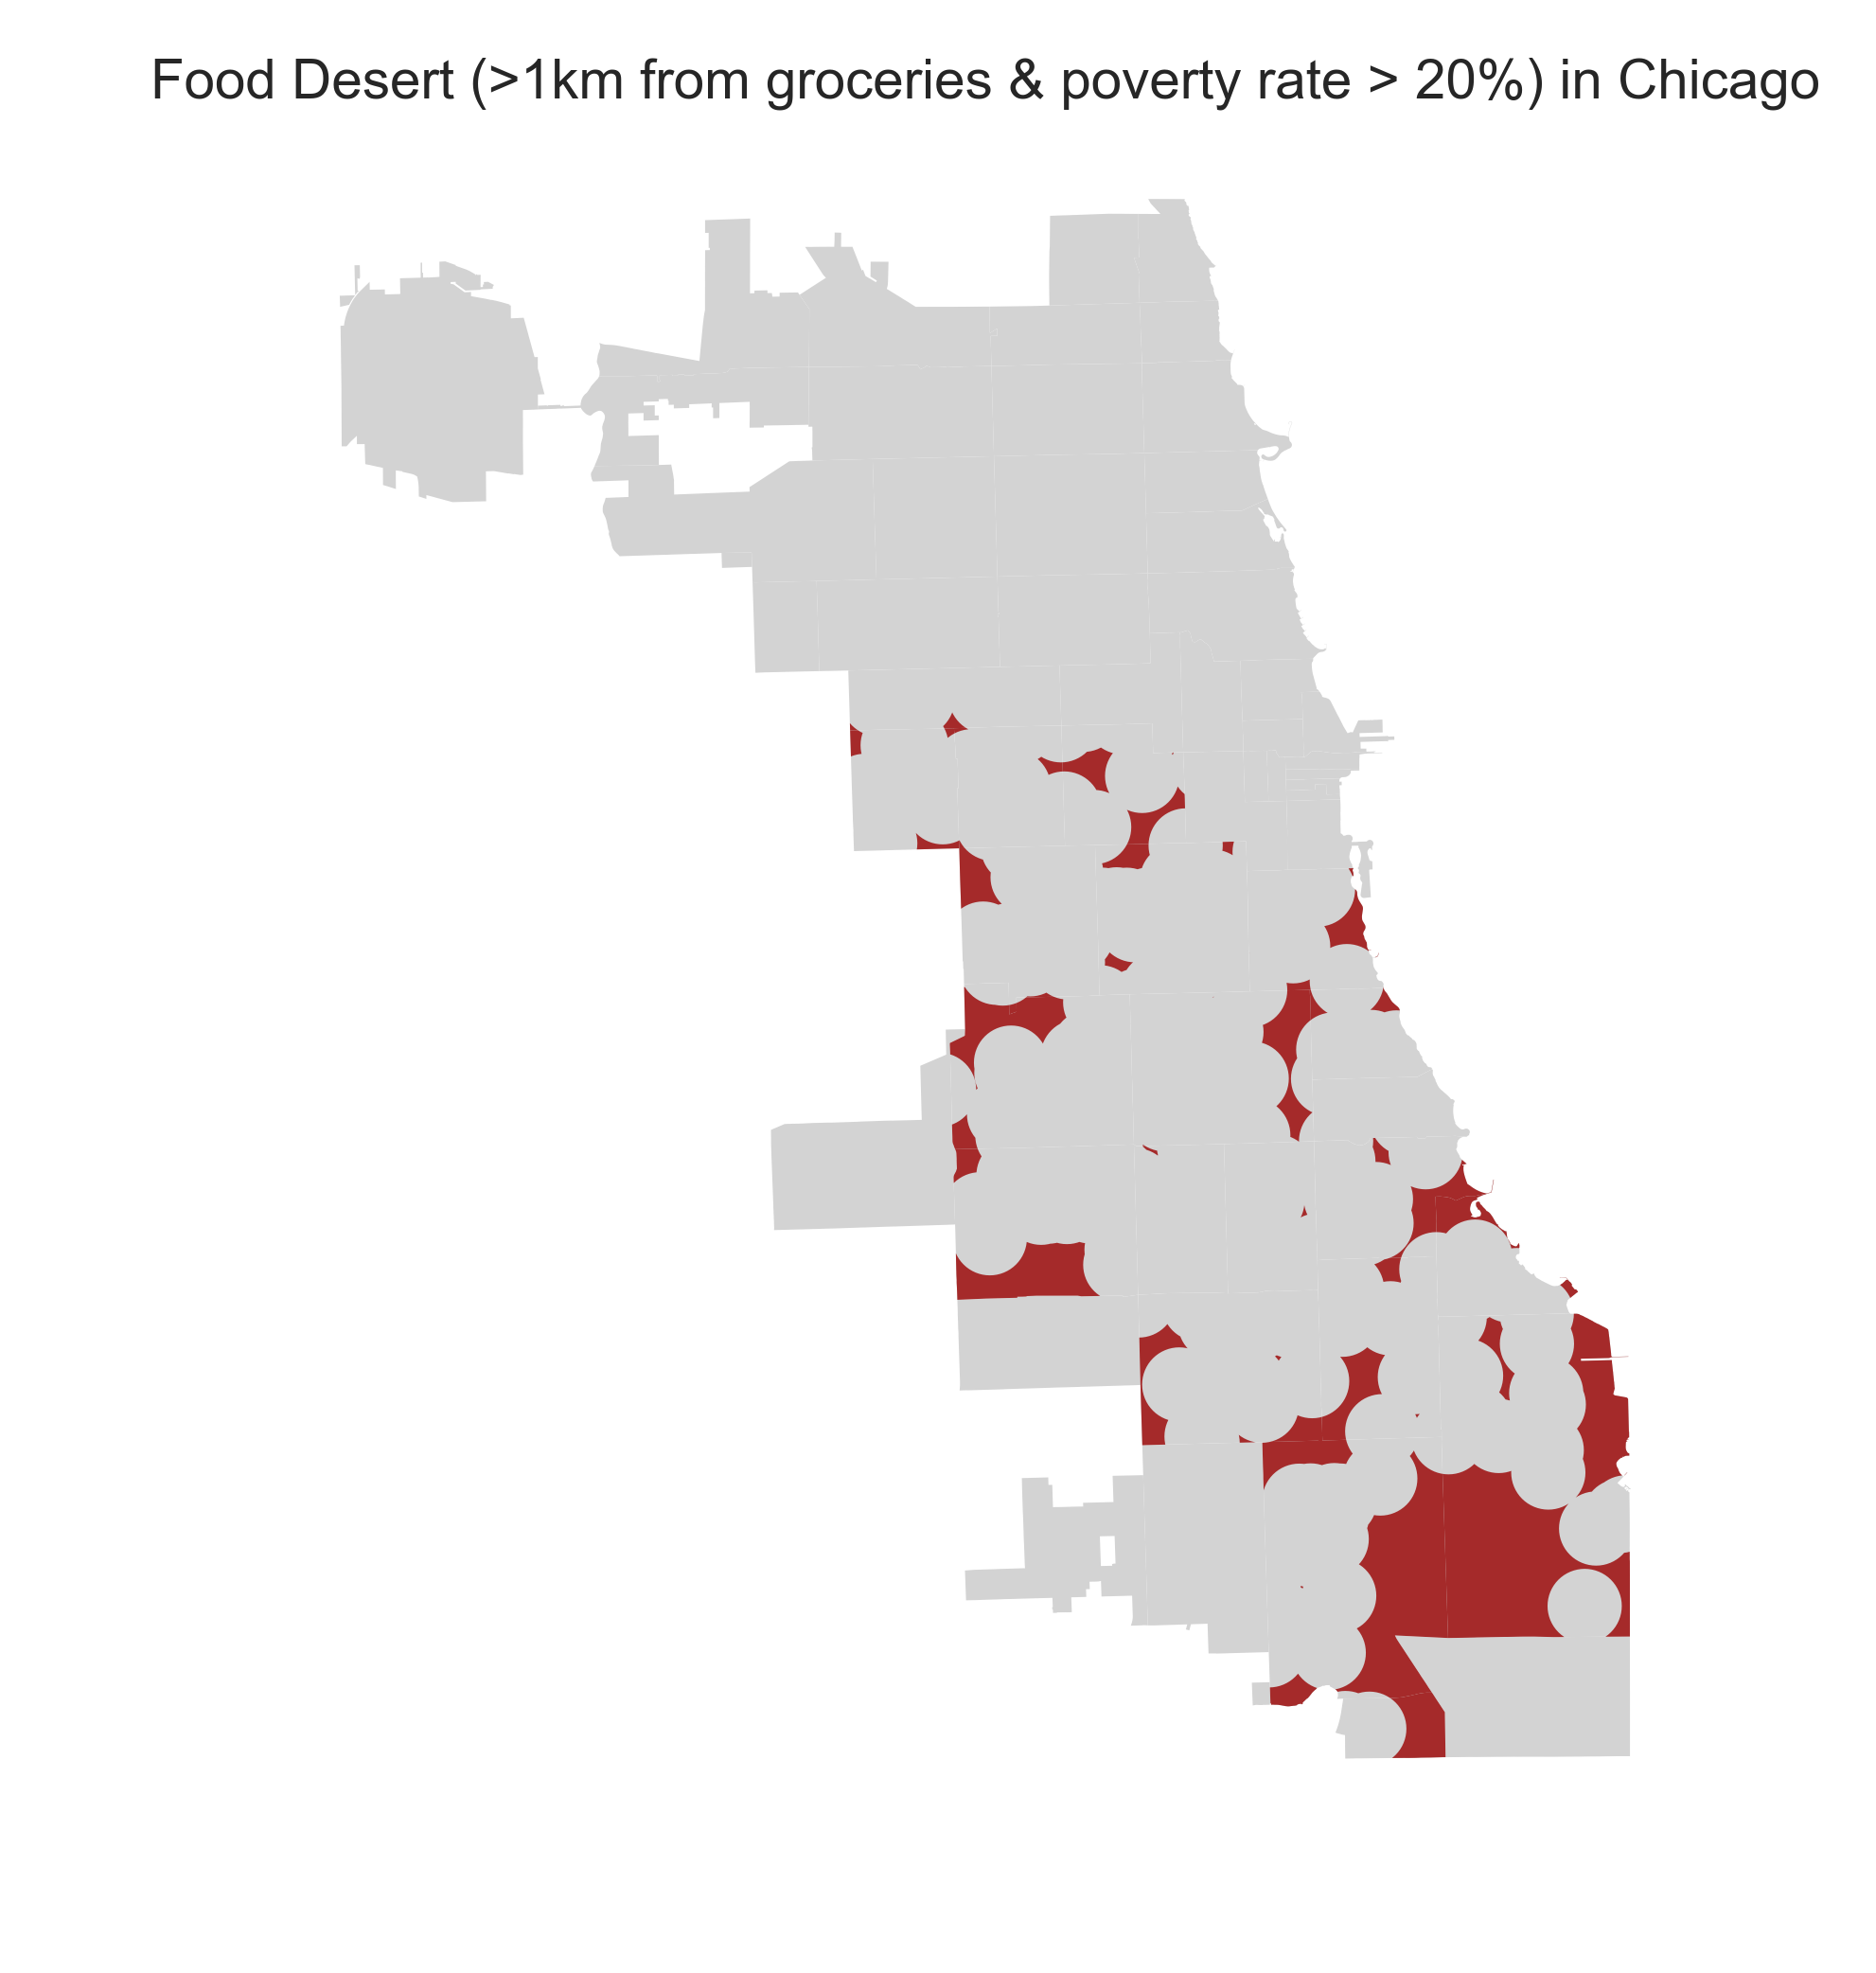
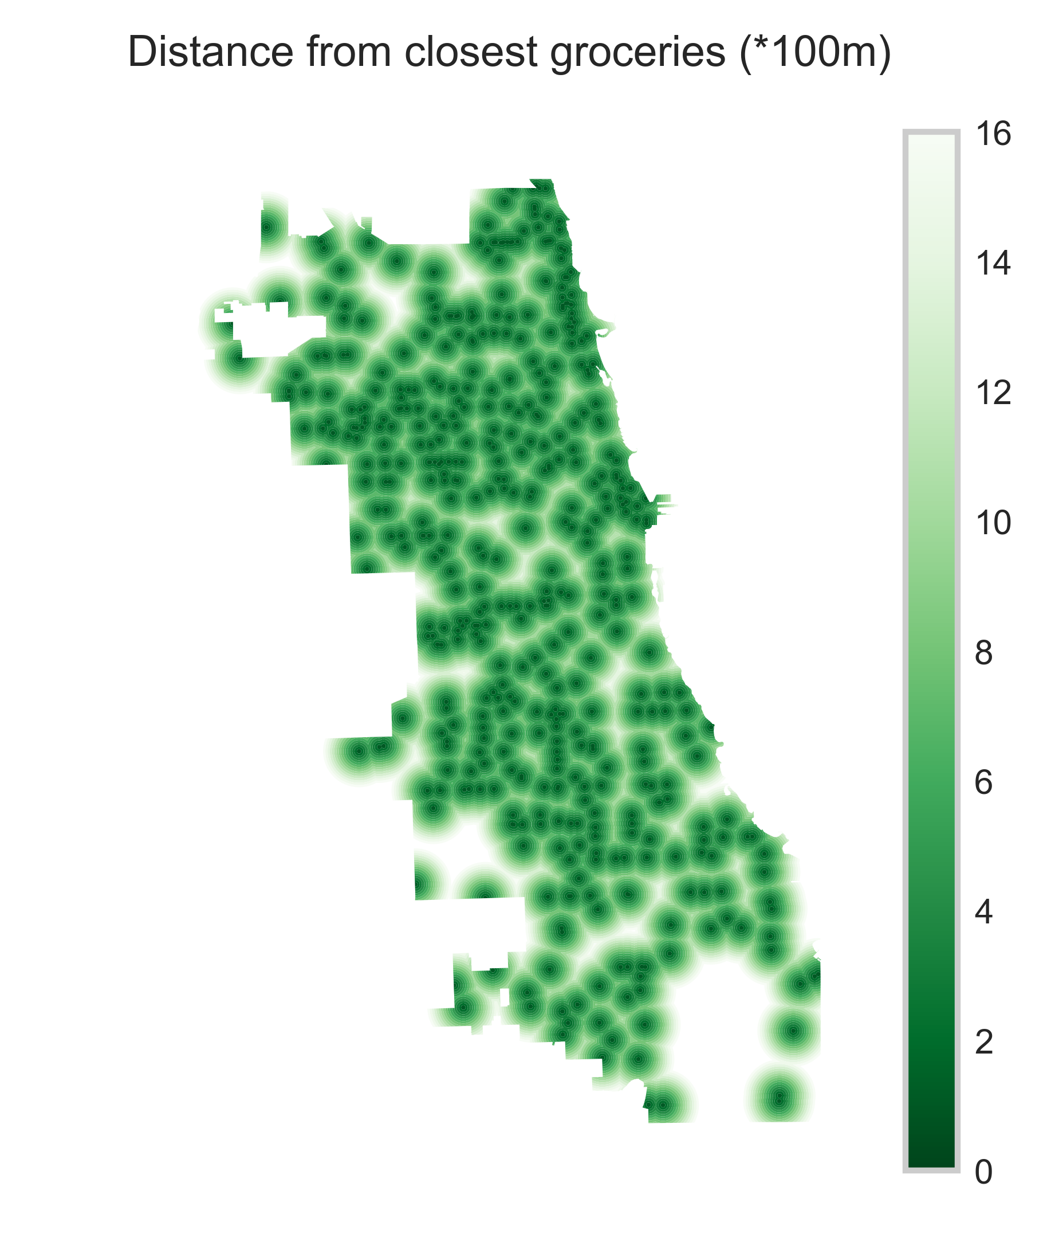
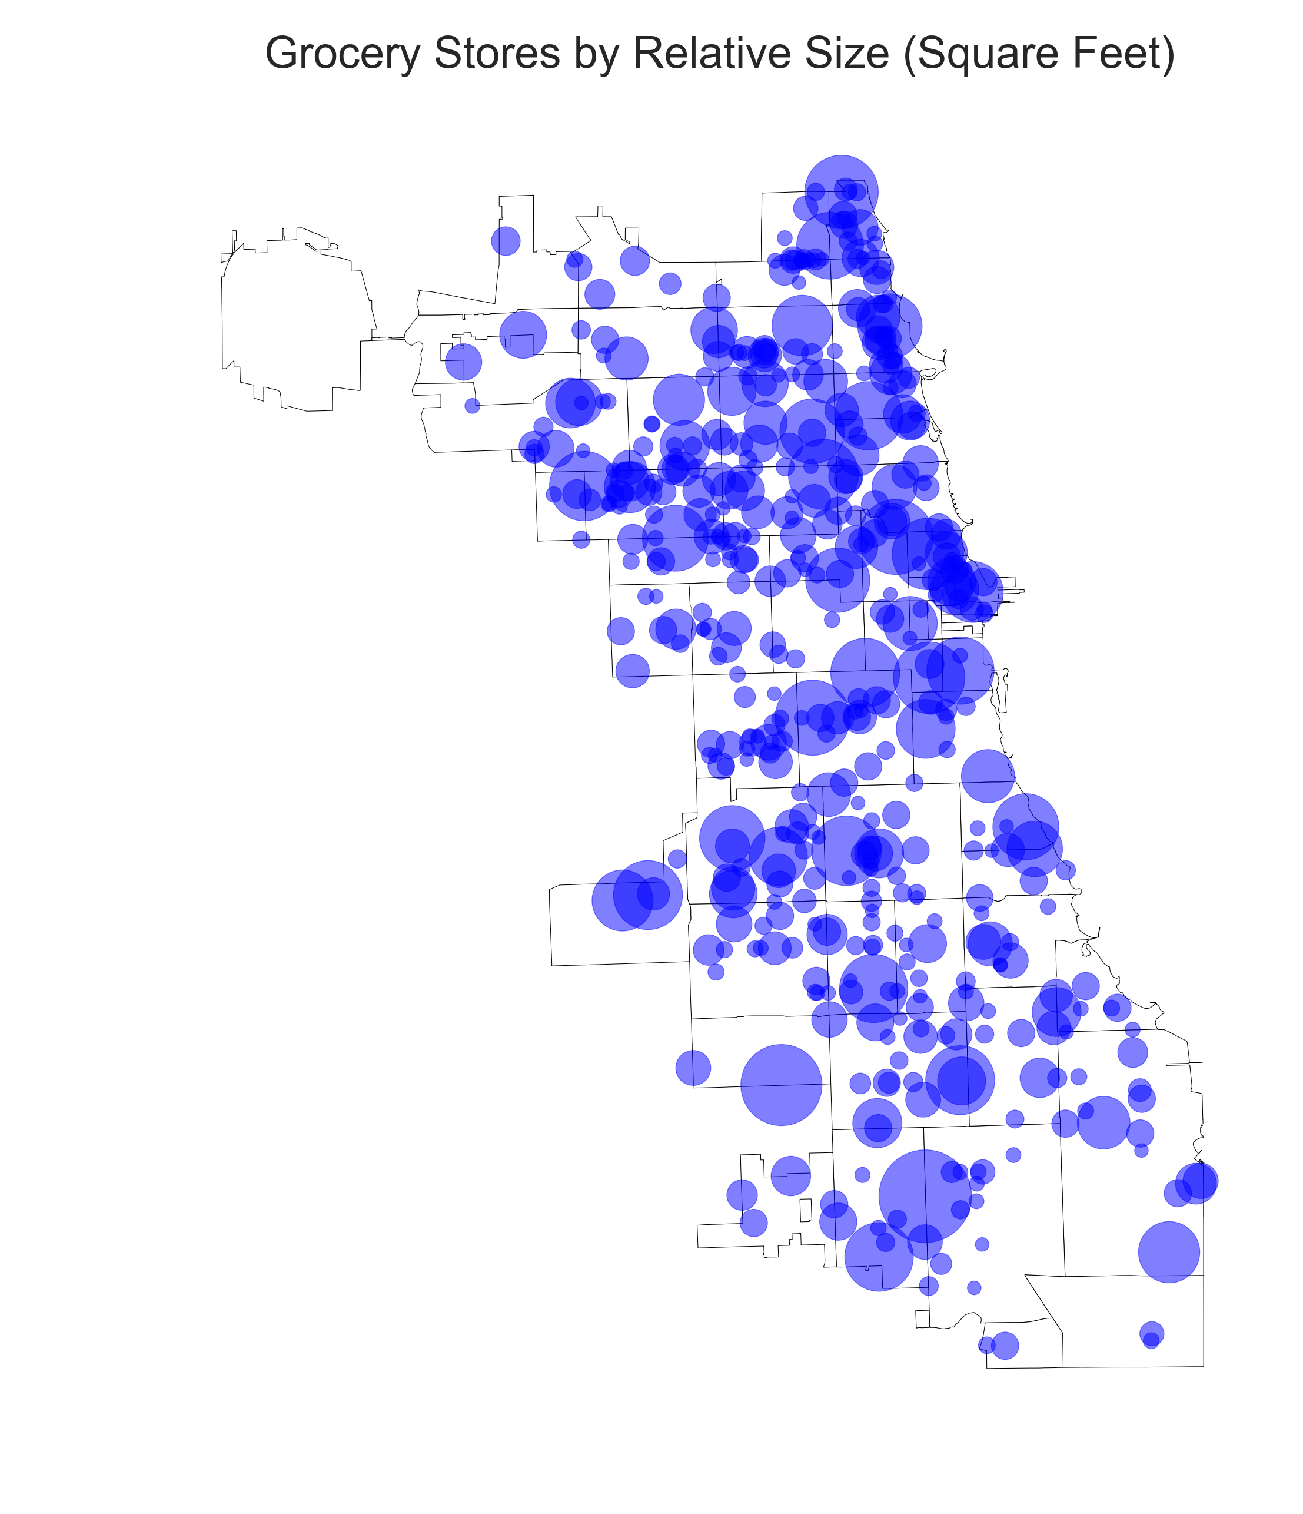
Food Deserts in Chicago
“Food desert” definition: an area with a poverty rate of at least 20 percent and where at least a third of the population lives more than a mile from a supermarket or large grocery store

Slide 5
Grocery density and diabetes hospitalization rates in zip-code areas

Slide 6
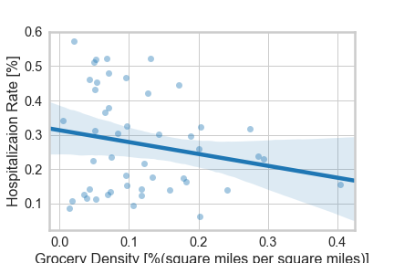
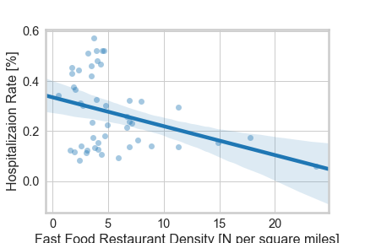
Plotting

Slide 7
OLS Regression
Model:
H(hospitalization rate) =
α(intercept)
+β1*G(grocery density)
+β2*F(fast food restaurant density)
+β3*Income(mean income)
+β4*Black(black rate)
+β5*Hispanic(hispanic rate)

Slide 8
Conclusion and limitations
We found weak but certain correlation between the grocery density and the diabetes hospitalization rate.
Health outcomes seem to be associated with minority population rather than food accessibility and income level.
Possible further research: tract level, other diseases (e.g. life expectancy or obesity), other cities (more samples)

